Slide 1
Predicting
Bond Yields using ESG Data

Slide 2
Project Statement
Objective
Design a model to predict the yield on bonds given both ESG metrics and financial data
Data Source and Structure
ESG and Financial data was selected on Bloomberg
Exported to Excel
Bond Ratings were found on Fitch, S&P, and Moody’s
Exported to Excel

Slide 3
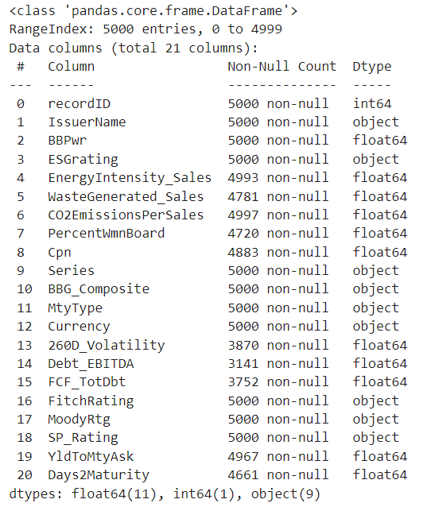
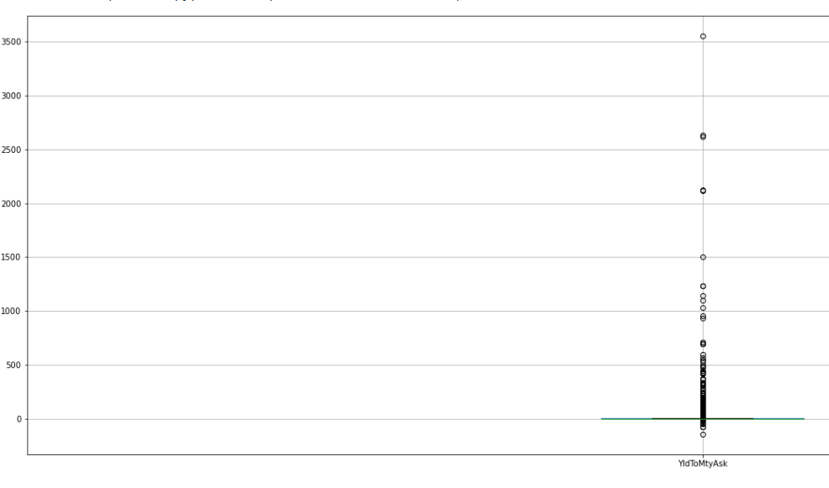
Data

Slide 4
Data Analysis
Data formatting is not ready for machine learning → needs to be cleaned
Missing data → drop for YldToMaturity
Use SimpleImputer or OneHotEncoder for other variables
Surprisingly no significant correlation between features
Yield had some outrageous outliers that hindered model performance
Dropped any value below 0 and above 100 for yield
This greatly improved model performance
RMSE with outliers: in the 70s
Ratings columns were missing over 20% of the data, filled with “Missing” in Excel
Notes:
Data preparation required including any dropping, adding, summarizing, imputation or encoding

Slide 5
Data Preparation
Fixed formatting of data (excel find and replace)
Created Day2Maturity column in order to make dates numeric for imputation (dropped maturity date column)
Dropped recordID / IssuerName because those are unique identifiers
Combined sparse categories that were too specific for credit ratings (combined records with more general classifications)
Dropped Series column (too sparse)
Use OrdinalEncoder on Ratings data

Slide 6
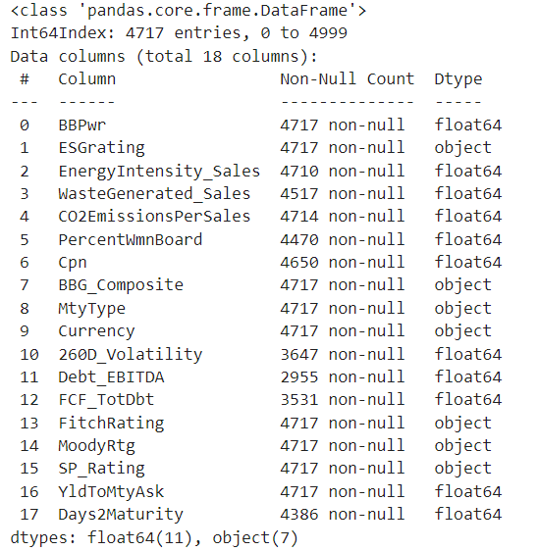
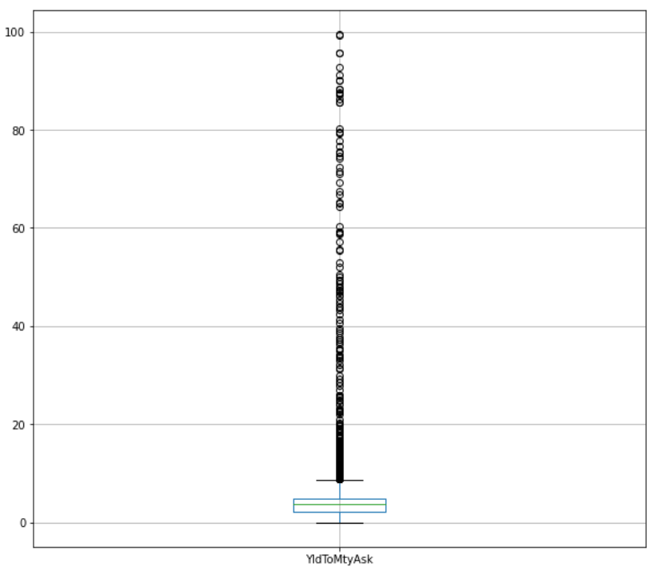
Data after Cleaning

Slide 7
Feature Engineering
We directly undertook feature engineering when deciding what data to pull from Bloomberg. Tried to get a mix of financial measures and ESG measures so we could see which features add more predictive power
Ran models with all data and models with just the ESG and Ratings data
Models with all data ran better, but just the ESG and Ratings data still had decent RMSE scores
Attempted to use PCA, but it made performance worse so did not pursue
However, it reduced the number of features from 2701 to 9 using n_components = 95
Points to some data being far too sparse for OneHotEncoder

Slide 8
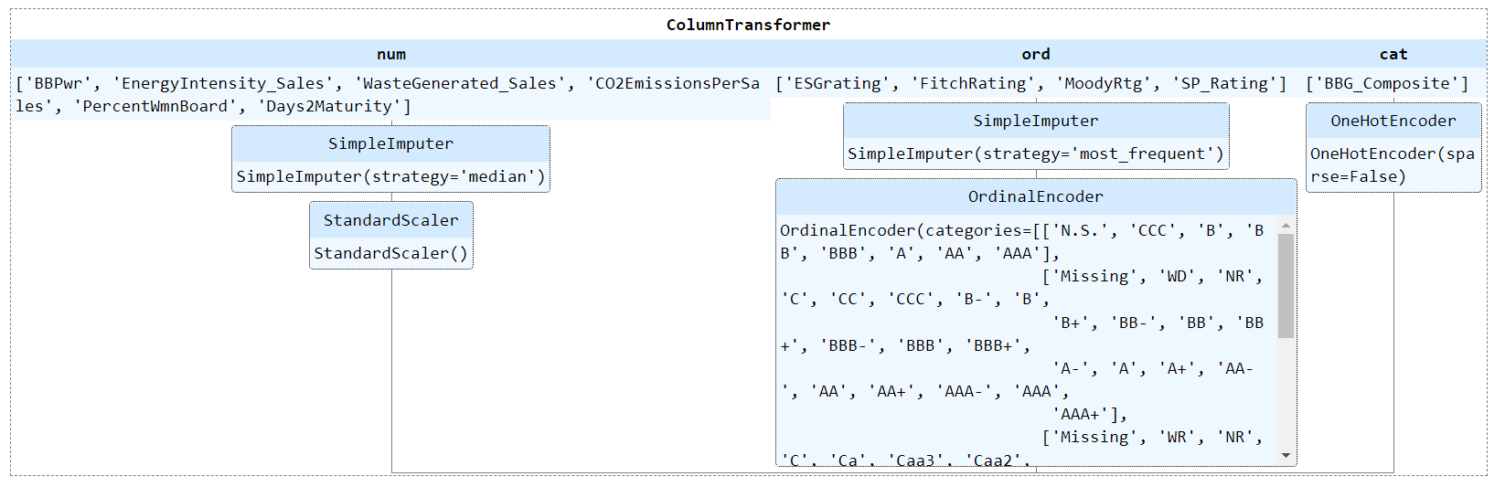
SKLearn Pipeline

Slide 9
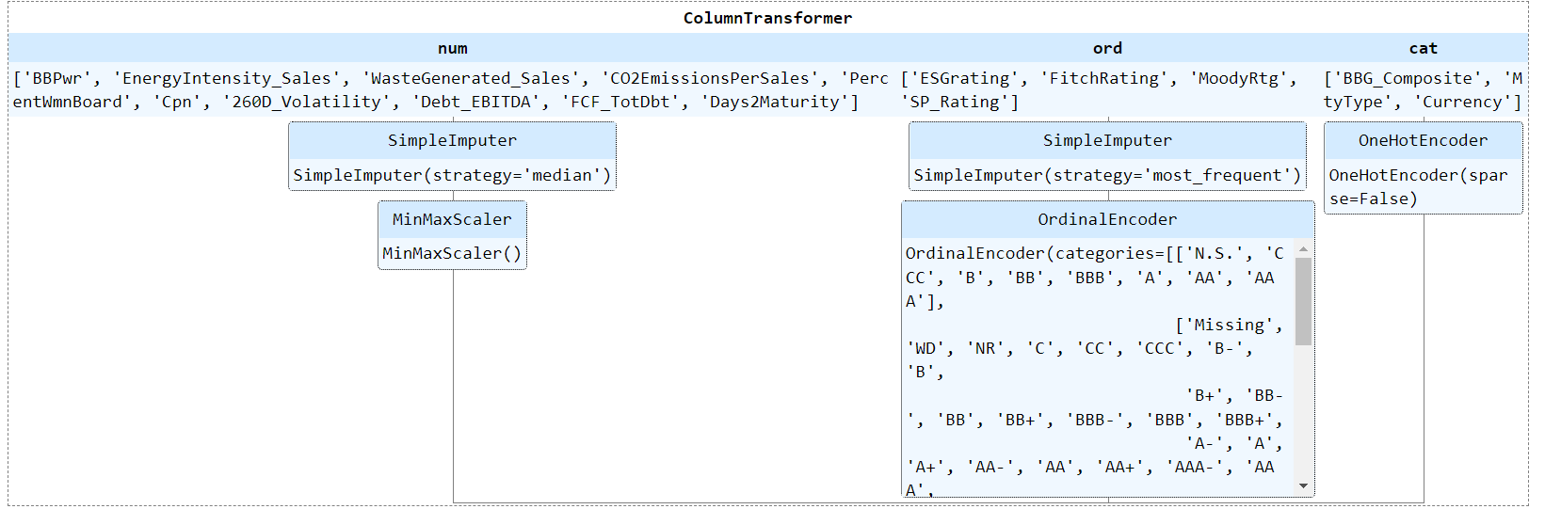
Neural Net Pipeline
Same as before, but used MinMaxScaler on numerical attributes

Slide 10
Baseline & Predictions
Baseline
Baseline RMSE of 7.38 based on the mean bond yield
Predictions
Prediction dataset is based on the first three records in the test dataset:
Country Garden Holdings Co Ltd, SSE PLC, and Cooperatieve Rabobank UA

Slide 11
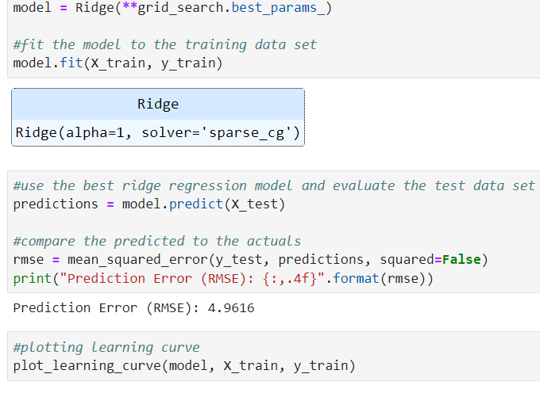
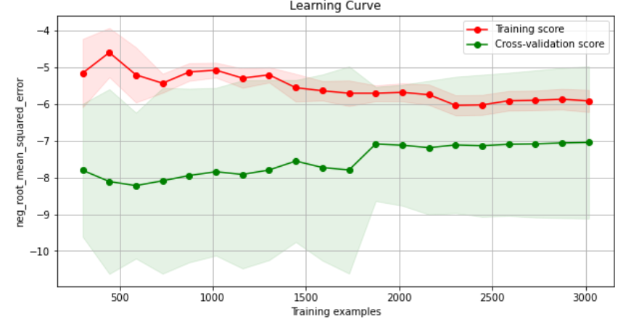
Ridge Regression
Fed all 72 features, tuned using GridSearchCV. Erratic learning curve

Slide 12
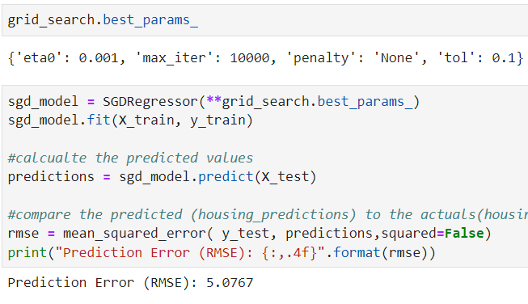
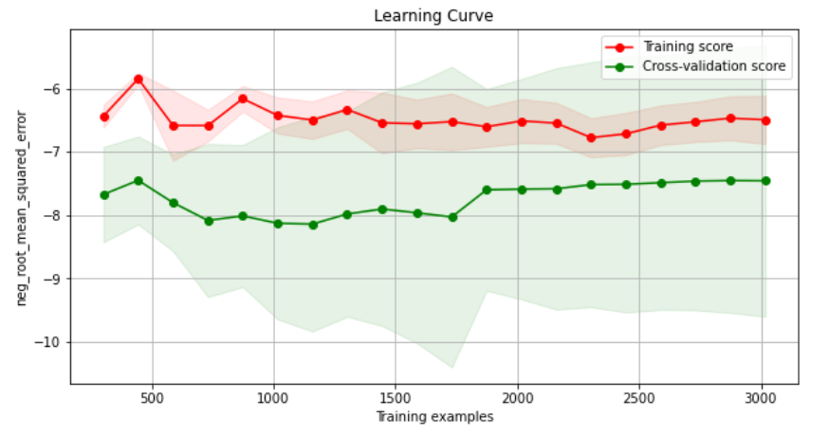
SGD Model
Fed all features (72 after pipeline). Tuned using GridSearch
Another erratic Learning Curve

Slide 13
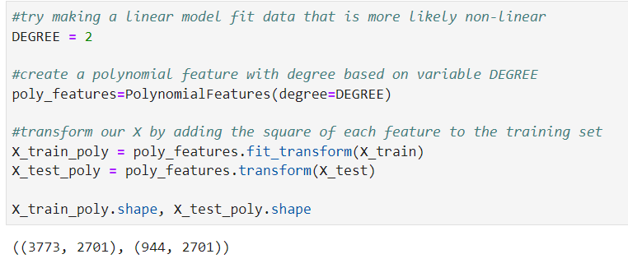
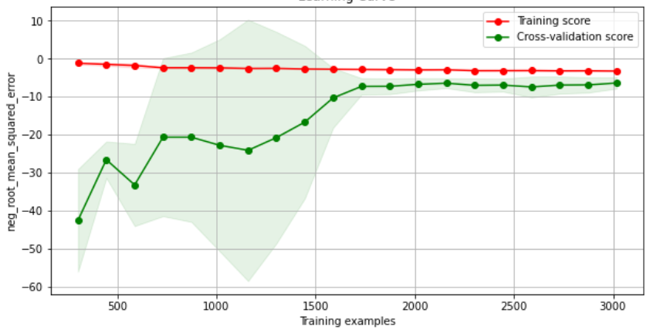
Lasso Reg with Polynomial Features
Data is reshaped to 2701 features. No hyperparameters to tune. Somewhat of a normal learning curve

Slide 14
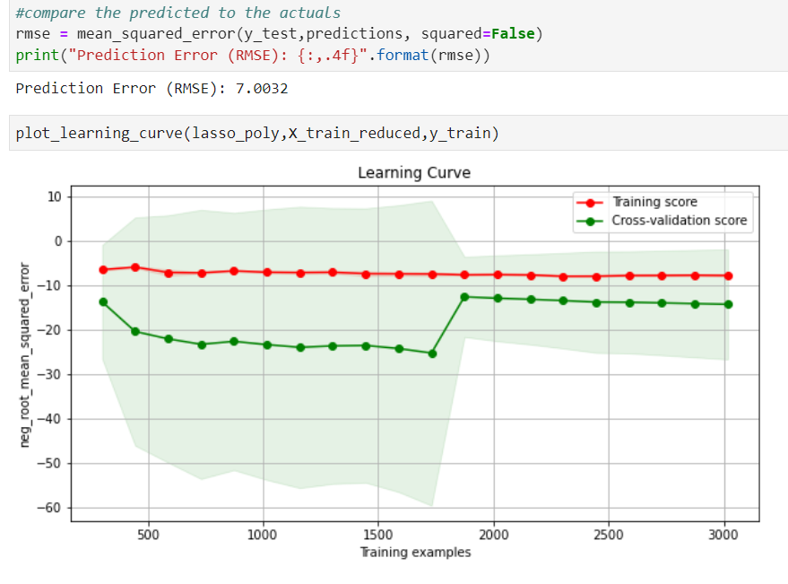
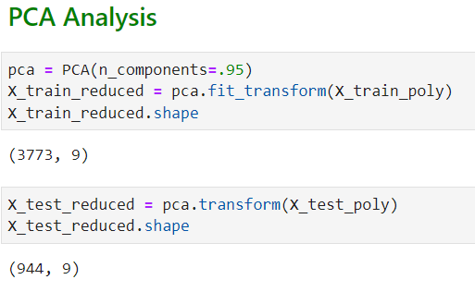
Lasso Polynomial - PCA
PCA reduced n_components from 2701 to 9 - previous poly models have been modeling lots of noise.

Slide 15
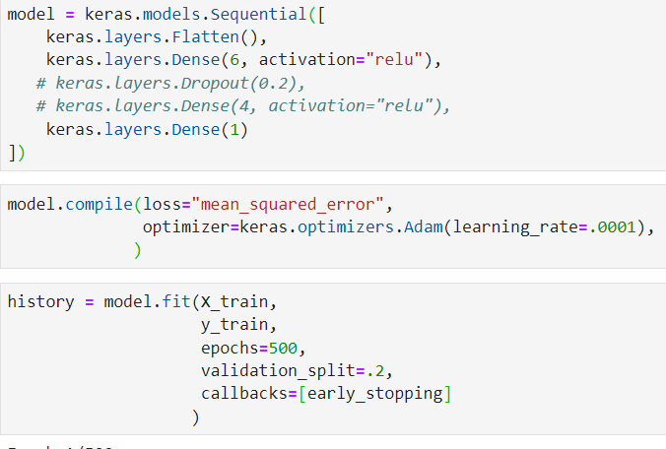
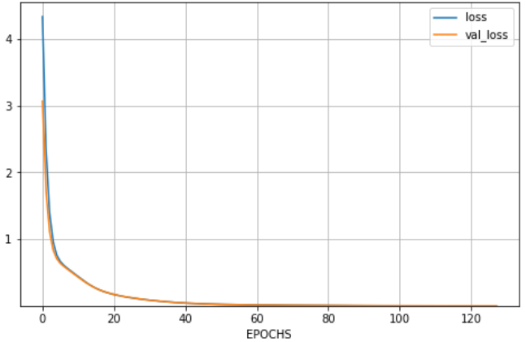
Neural Net - All Data
Design and Performance of first Neural Network with all data fed through (72 features)

Slide 16
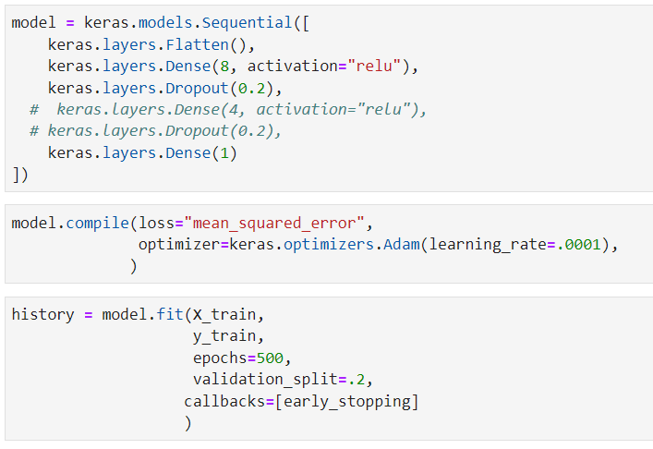
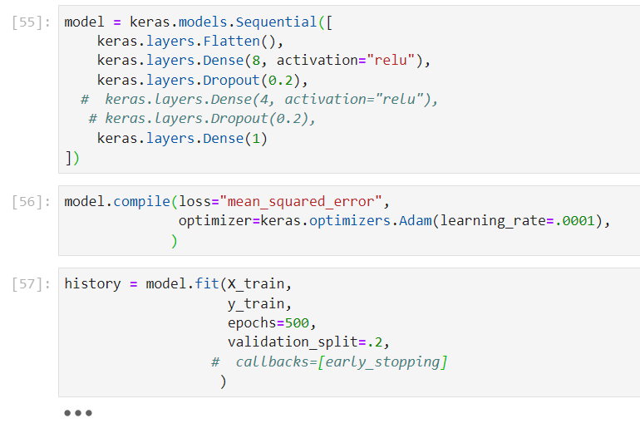
Neural Net - Subsets of Data
NN with only ESG data (29 features total). A second deep layer did not improve performance.
NN without ESG data (11 features total). Early Stopping did not help performance so it was removed. Learning Curve included later in the presentation.

Slide 17
Model Performance - SKLearn Models
Model | Training RMSE | Test RMSE | Prediction 1 | Prediction 2 | Prediction 3
Lin Reg All Data | 11.49 | 4.99 | 6.76 | 7.17 | 18.89
Ridge Reg All Data | 7.02 | 4.96 | 7.41 | 7.24 | 19.16
SGD Reg All Data | 7.18 | 5.08 | 8.82 | 6.31 | 15.39
Lasso Reg All Data | 7.29 | 5.49 | 7.83 | 7.33 | 15.06
Ridge Poly All Data | 6.2 | 6.17 | 6.66 | 6.66 | 28.27
Lasso Poly All Data | 6.68 | 4.26 | 6.88 | 4.96 | 14.07
Lasso Poly PCA | 12.7 | 7 | 8.75 | 6.22 | 11.01
Lasso Poly Only ESG | 7.74 | 6.81 | 8.51 | 7.33 | 12.84
Actual Values |  |  | 4.95 | 2.97 | 4.45
Notes:
5 well-tuned models that include appropriate and comparable performance metrics on a test data set as well as the 3 sample instances. Note: at least one (but not all) of the well-tuned models should be a neural network.

Slide 18
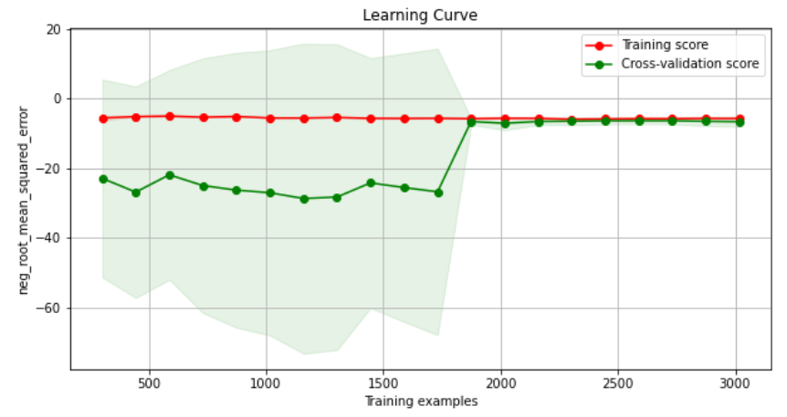
Lasso with Polynomial Features - All Data

Slide 19
Model Performance - Neural Nets
Model | Training RMSE | Test RMSE | Prediction 1 | Prediction 2 | Prediction 3
NN All Data | 5.73 | 5.3 | 6.78 | 4.49 | 25.52
NN No ESG | 4.67 | 4.20 | 4.08 | 4.08 | 26.21
NN Only ESG | 7.52 | 6.34 | 4.21 | 4.52 | 7.61
Actual Values |  |  | 4.95 | 2.97 | 4.45
Notes:
5 well-tuned models that include appropriate and comparable performance metrics on a test data set as well as the 3 sample instances. Note: at least one (but not all) of the well-tuned models should be a neural network.

Slide 20
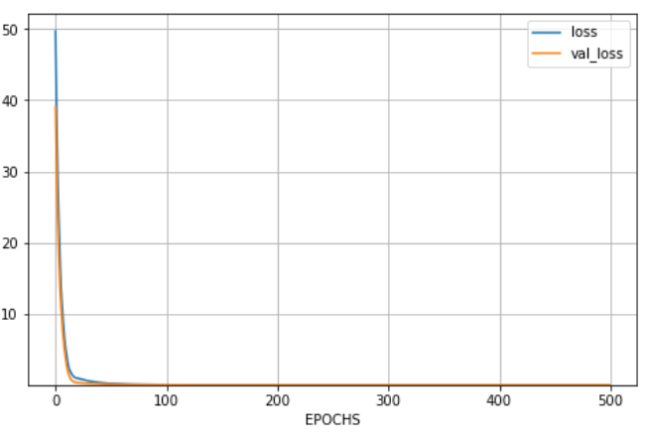
Neural Net with No ESG Data

Slide 21
Model Bias
Potential issues with par value discrepancies
Considerable amount of missing data
Different types of currencies in the dataset
All models overshoot the third prediction instance by a lot - requires further analysis to understand why.

Slide 22
Summary
We recommend a Neural Net without ESG data.
According to our analysis, this model performs the best as far as test RMSE
It also has a healthy learning curve with no overfitting
Potential concerns:
It massively overshoots the third prediction instance (as do all models), so clearly it is biased against something in this record
Its predictions for the first two instances are identical
Perhaps the model can’t differentiate enough between bonds with low yields but overcompensates on bonds with high yields
We recommend gathering more numerical data on the bond and bond issuer to more accurately predict the bond’s yield.

